Slide 1

Student Result Processing Management System ...
21107036 : Aman Dhumal
21107053 : Om D Jondhale
21107021 : Rahul Gangurde
21107058 : Prathamesh Babar
Project Guide
Ms. Rajashri Chaudhari

Slide 2
Contents
Introduction
Objectives
Scope
Features / Functionality
Project Outcomes
Technology Stack
Block Diagram if applicable

Slide 3
1. Introduction
Problem Identified :
How to check the Result of Examination in a simple way ?
Solution Proposed :
The main objective of the project is to provide the examination result to the student in a simple way. This project is useful for students and institutions for getting the results in simple manner .

Slide 4
2. Objectives
To develop a simple and feature packed Student result management system.
To develop a system which will make the process of viewing and storing result easier .
To design a table which will display all the marks of the student .
To make adding student information in the system easier for the admin.
To Display the Status that is Student is passing or failing .

Slide 5
3. Scope
Students can view result anytime .
Can be useful to quickly view the marks of the student .
Useful for students and teachers to easily manage student marks .
User friendly interface for interaction between user and the system.
Will make the process of adding result and information of students easier and simple

Slide 6
4. Feature /Functionality
Feature 1 -
Provides the result storing facility for storing marks of various subjects ( physics,chemistry,maths ).
Feature 2 -
Student result management system can also manage the basic information of the students e.g Their name, id , roll number, gender etc.
Feature 3 -
It shows all this information to the student in a single page.
Feature 4 -
Shows the Status of student i.e the student is passing or failing .
Feature 5
- Removing, adding and updating student records is simple .

Slide 7
5. Technology Stack
Technology Used :
JDK (Java Development Kit) 8.0
JDBC (Java Database Connectivity)
Development Tools:
NetBeans 15 IDE
MySQL 8.0

Slide 8
7.Outcome of Project
User can login
User can see the result of the students after entering roll number
User can see their name, fathers name, roll number and their marks .
marks will be displayed per subject and will also display if student is passed or failed the semester.
admin will be the one adding all the information of student and about their marks .

Slide 9
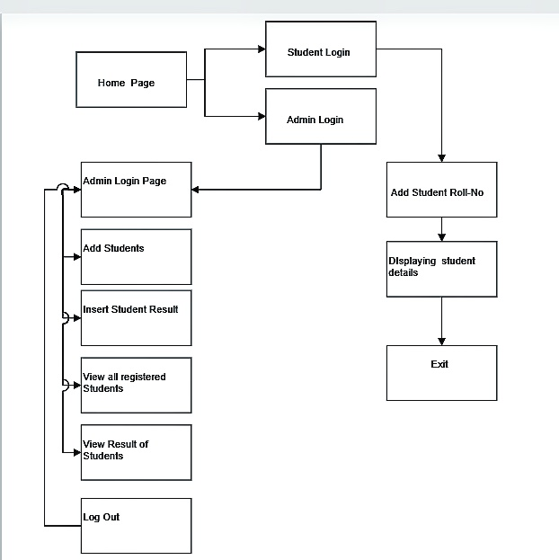
6. Block Diagram

Slide 10
Thank You...!!

